Slide 1

ORACLE SQL – TALEND ETL PROJECT ONLINE CINEMA RESERVATION HELLO DATA
ZEYNEP AVCI
İSA YAVUZ
FIRAT YORULMAZ

Slide 2
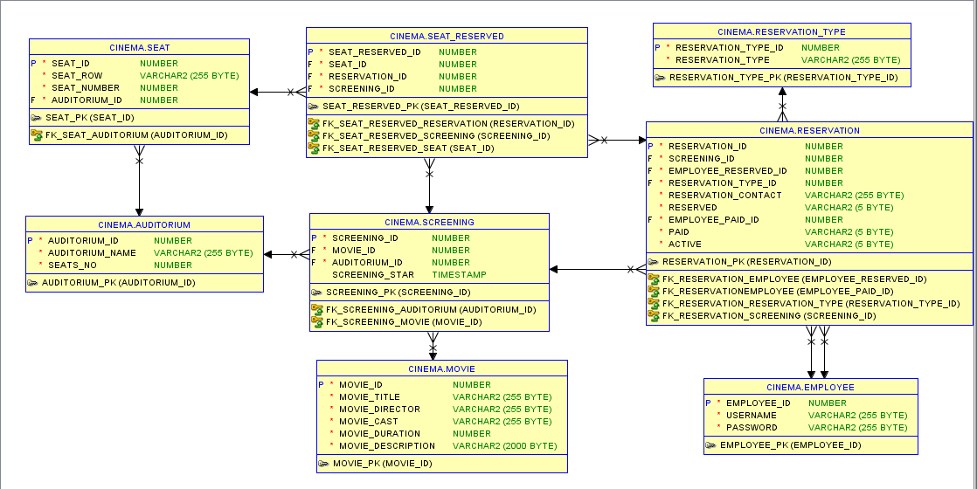
DATA MODELER

Slide 3
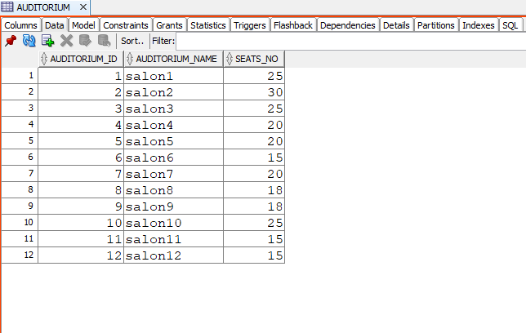
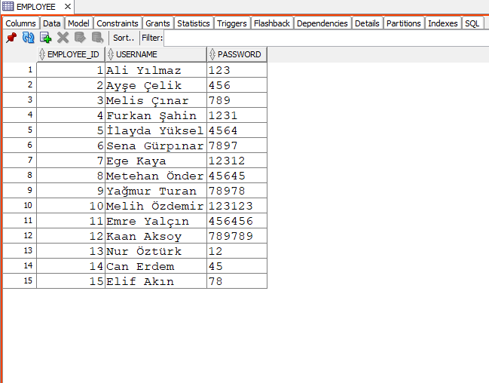
DATA MART
AUDITORIUM
EMPLOYEE

Slide 4
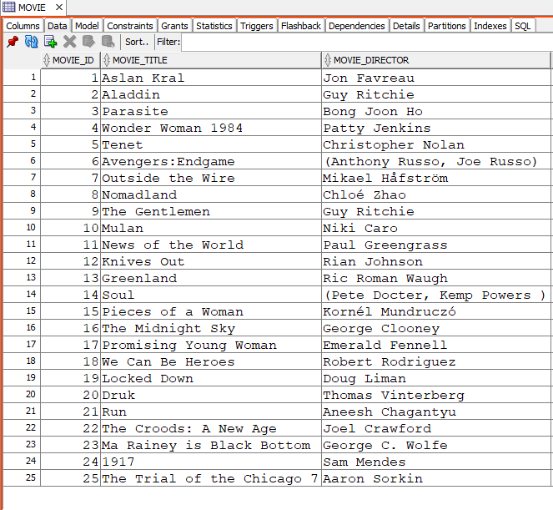
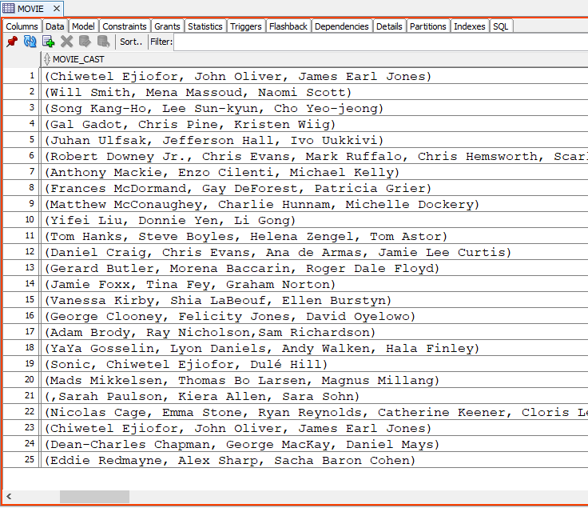
DATA MART
MOVIE

Slide 5
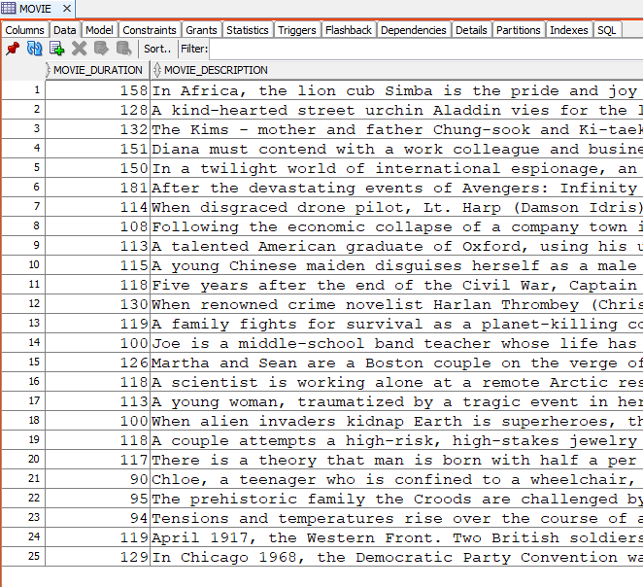
DATA MART
MOVIE

Slide 6
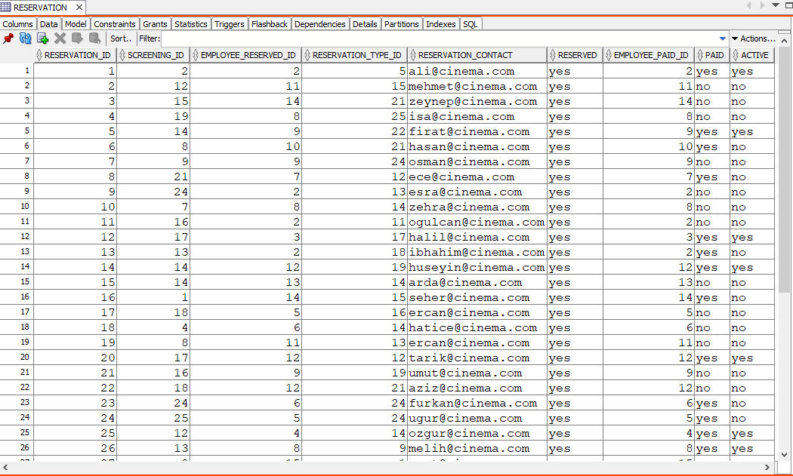
DATA MART
RESERVATION

Slide 7
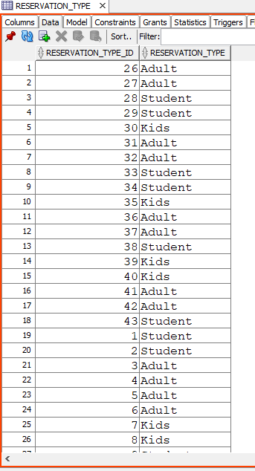
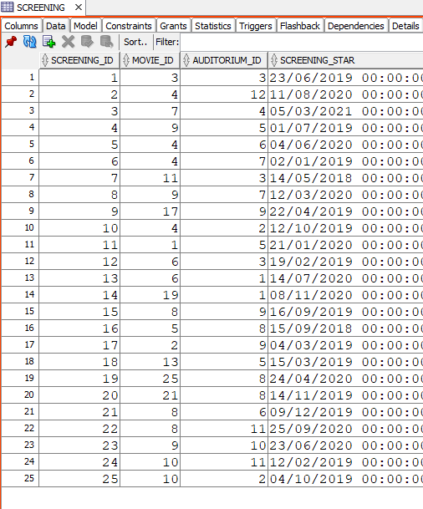
DATA MART
RESERVATION TYPE
SCREENING

Slide 8
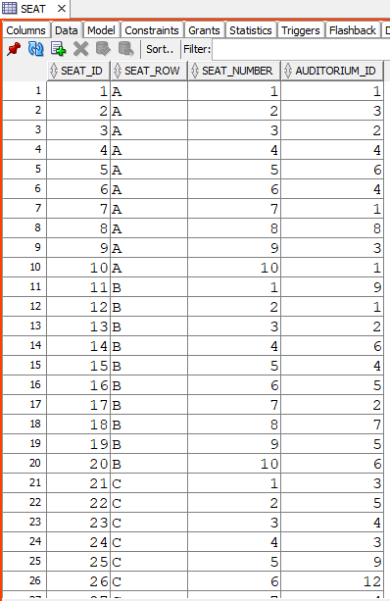
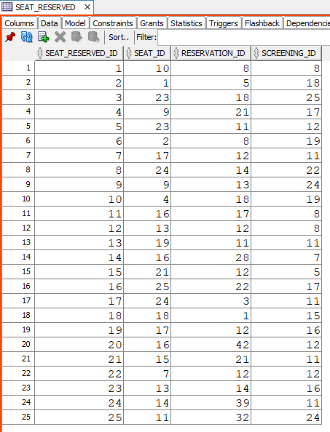
DATA MART
SEAT
SEAT RESERVED

Slide 9
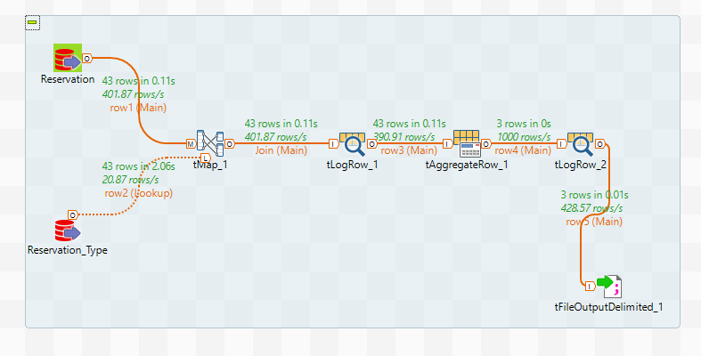
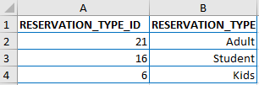
2 TABLES WITH JOIN and AGGREGATE FUNCTION
TALEND ETL

Slide 10
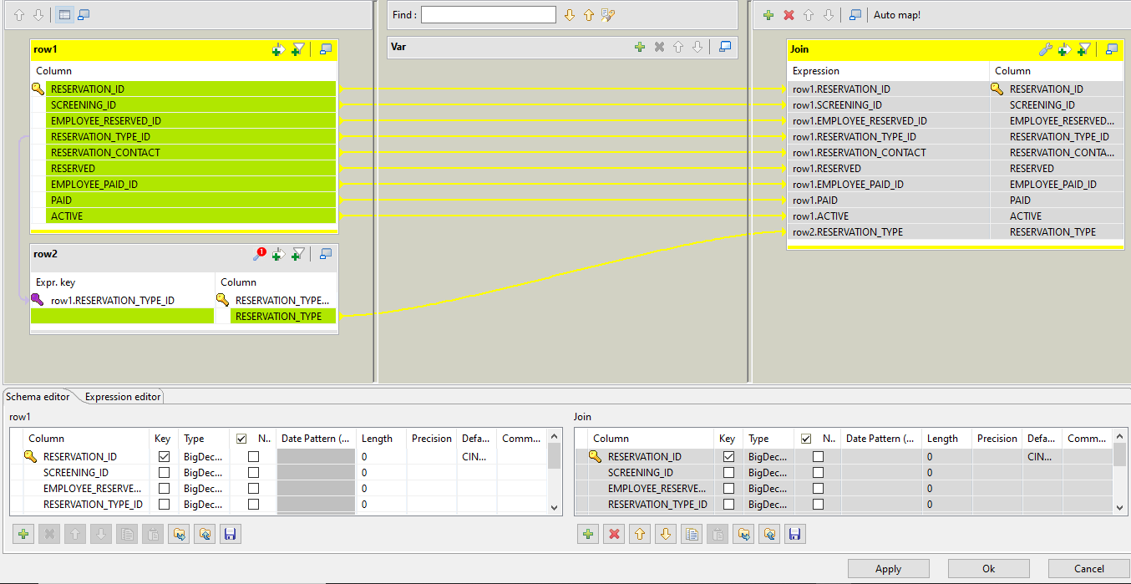
2 TABLES WITH JOIN and AGGREGATE FUNCTION
TALEND ETL

Slide 11
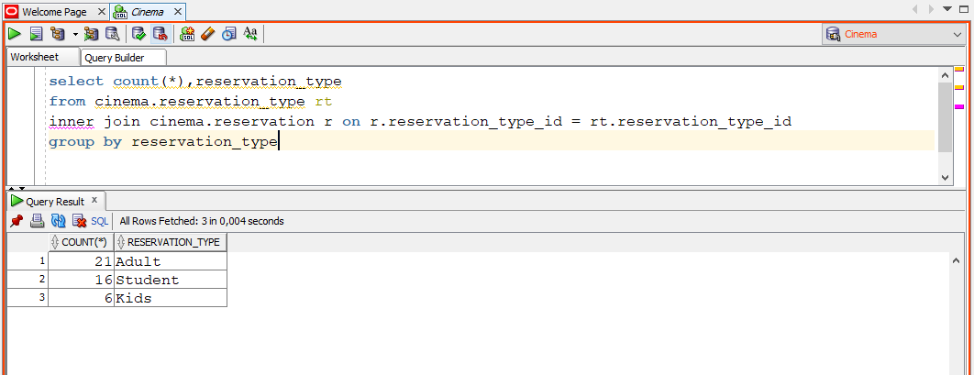
2 TABLES WITH JOIN and COUNT FUNCTION
TALEND ETL

Slide 12
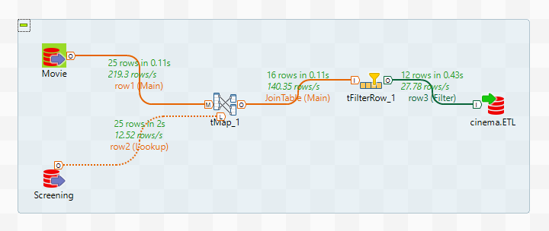
2 TABLES WITH JOIN and FILTER FUNCTION
TALEND ETL

Slide 13
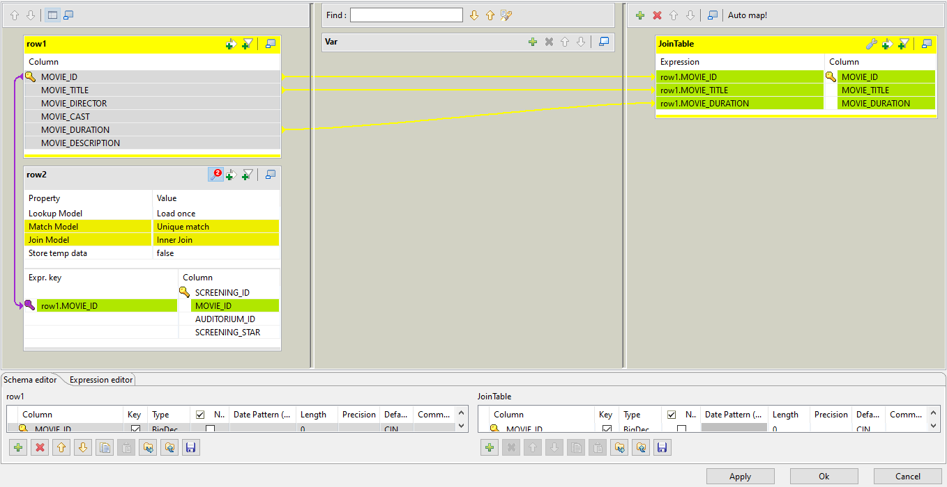
2 TABLES WITH JOIN and FILTER FUNCTION
TALEND ETL

Slide 14
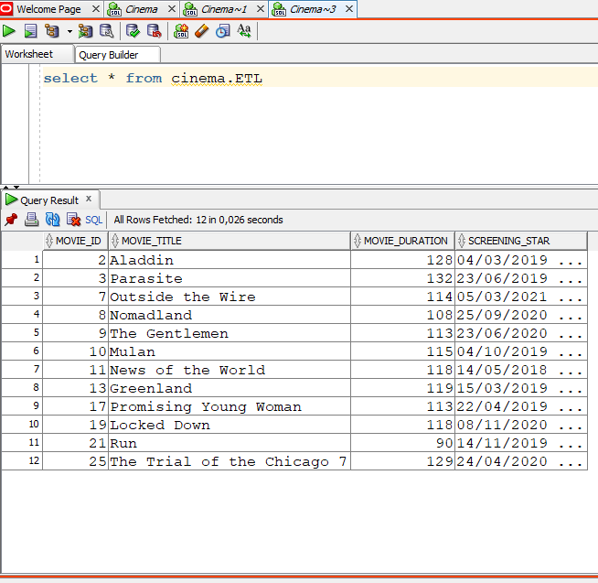
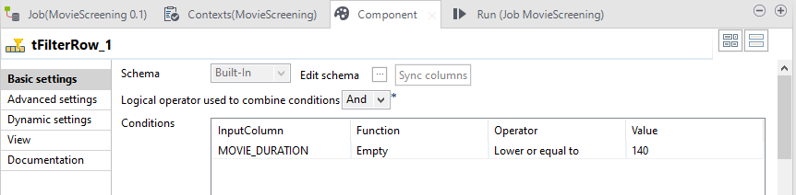
2 TABLES WITH JOIN and FILTER FUNCTION
TALEND ETL

Slide 15
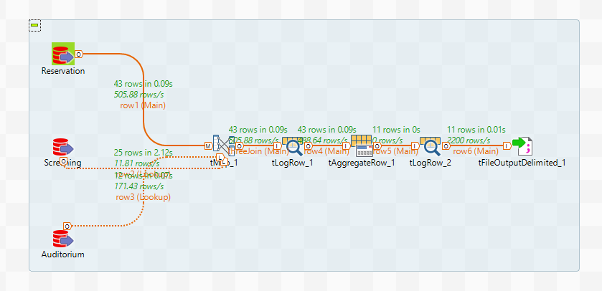
3 TABLES WITH JOIN and AGGREGATE FUNCTION
TALEND ETL

Slide 16
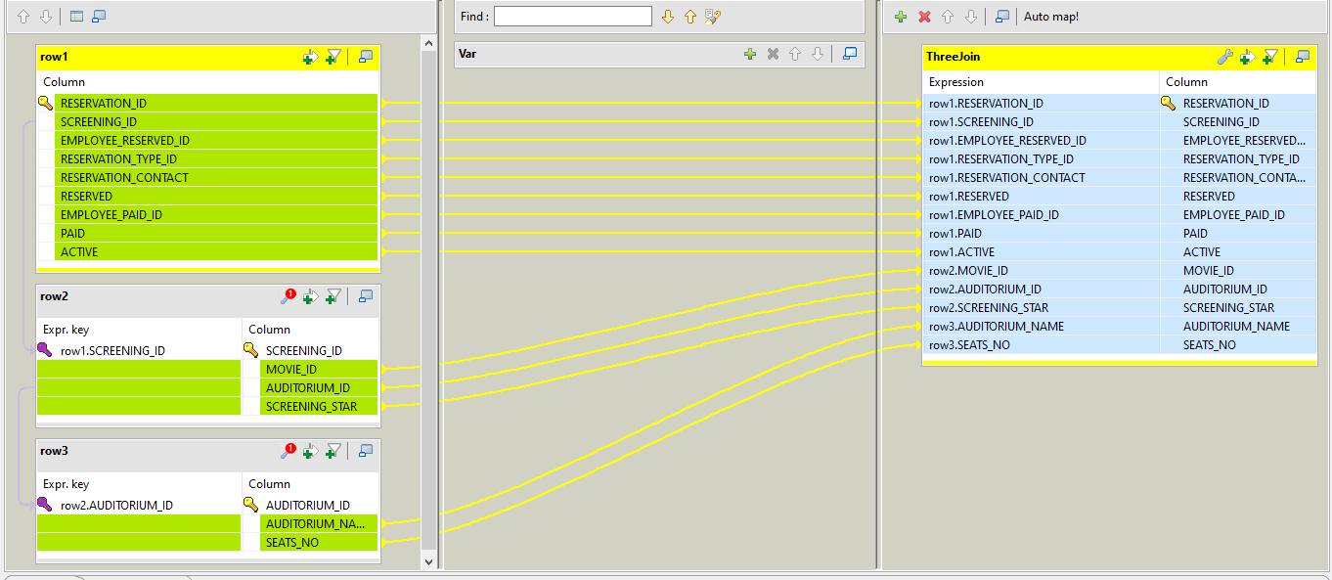
3 TABLES WITH JOIN and AGGREGATE FUNCTION
TALEND ETL

Slide 17
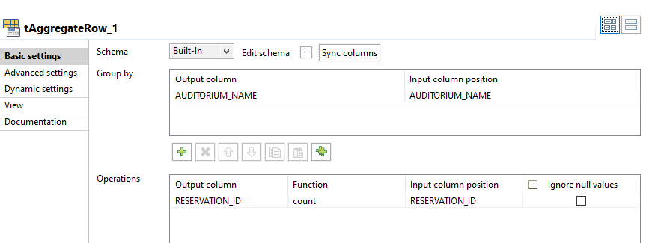
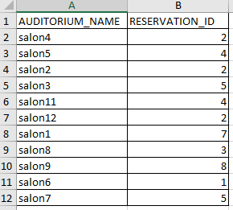
3 TABLES WITH JOIN and AGGREGATE FUNCTION
TALEND ETL

Slide 18
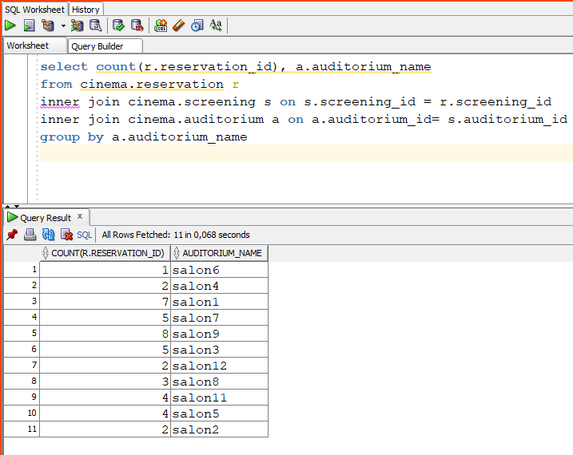
3 TABLES WITH JOIN and AGGREGATE FUNCTION
TALEND ETL

Slide 19
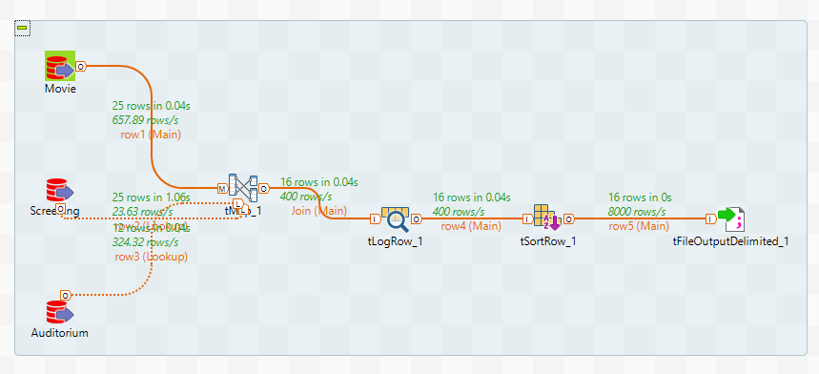
3 TABLES WITH JOIN and SORT FUNCTION
TALEND ETL

Slide 20
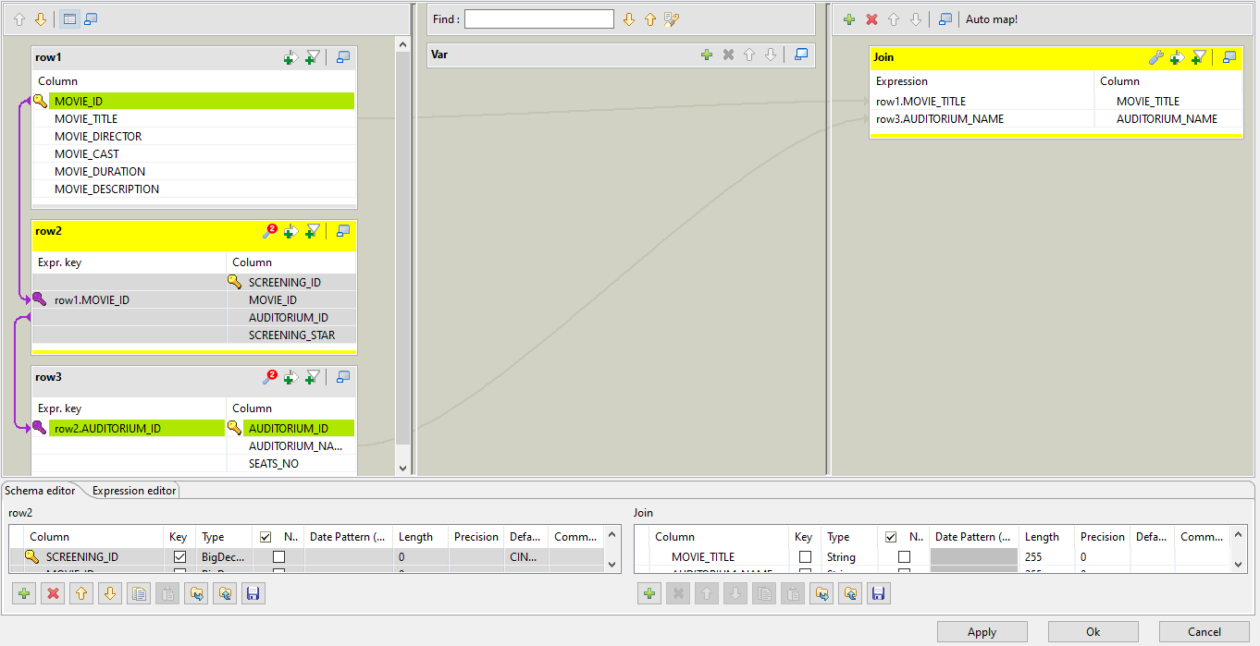
3 TABLES WITH JOIN and SORT FUNCTION
TALEND ETL

Slide 21
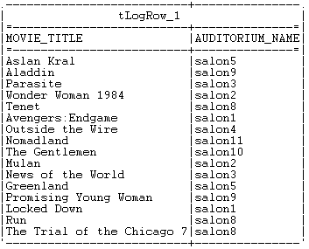
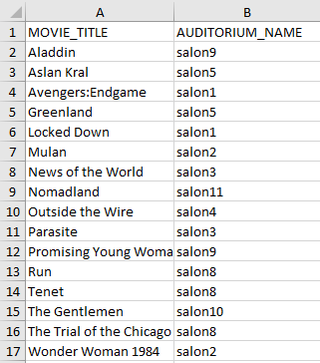
3 TABLES WITH JOIN and SORT FUNCTION
TALEND ETL

Slide 22

THANK YOU FOR LISTENING! HELLO DATA

